Slide 1
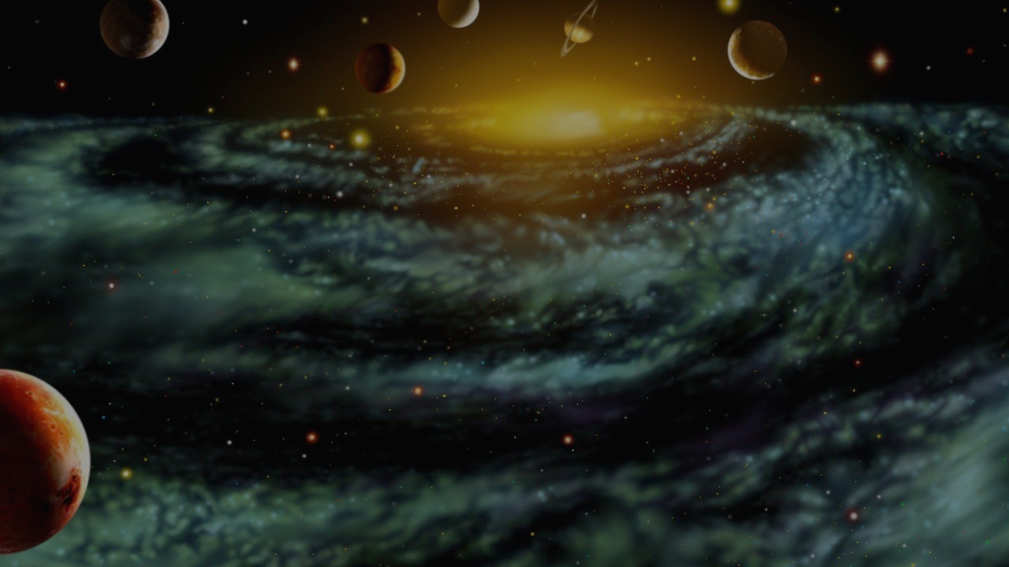
Solar System - Simulation
Seth Kaminski - 300788677
Selina Daley - 300792374
Khandker Hussain - 300773610
Slade Sieger - 300814981

Slide 2
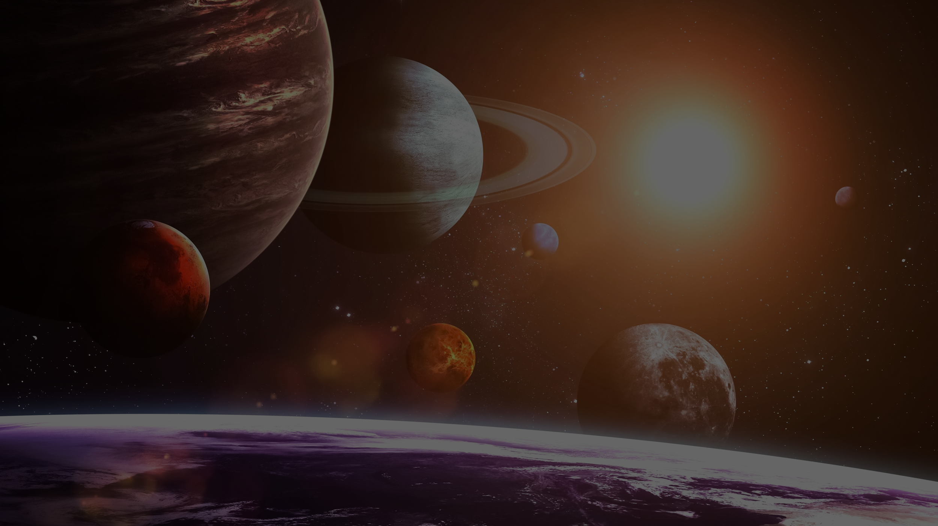
Implementation of Components
Physical Components
We have sphere objects that represents the planets and the sun
We use spheres because planets are shaped as spheres
Skybox is set to represent space
Empty space to look and feel like the vacuum of space
Asteroids “colliding” with planets
To show and represent how the planets’ gravitational pull works with incoming objects (asteroids)
Notes:
Seth and Selina if you want to add stuff feel free to put them here

Slide 3
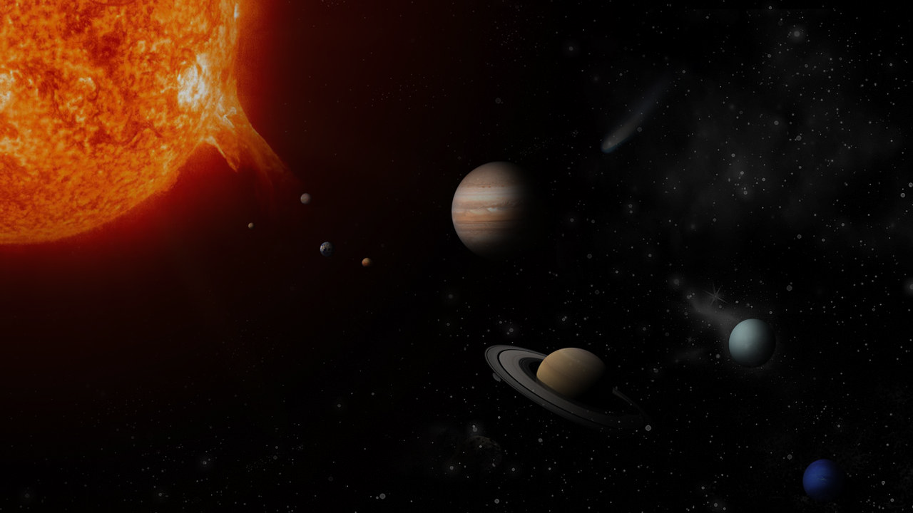
Implementation of Components (Cont)
Functional Components
UI that has a slider that allows the user to manipulate the time of the simulation via Unity’s timescale
We’re using timescale to allow us to see how the planets of the solar system revolve the sun in moments rather than having to wait years for them to finish a cycle
Gravity is simulated on each of the planets by showing their cycle around the sun as well as spawning asteroids that reacts to the gravitational pull of the planets
To see how the gravity of the planets and asteroids work

Slide 4
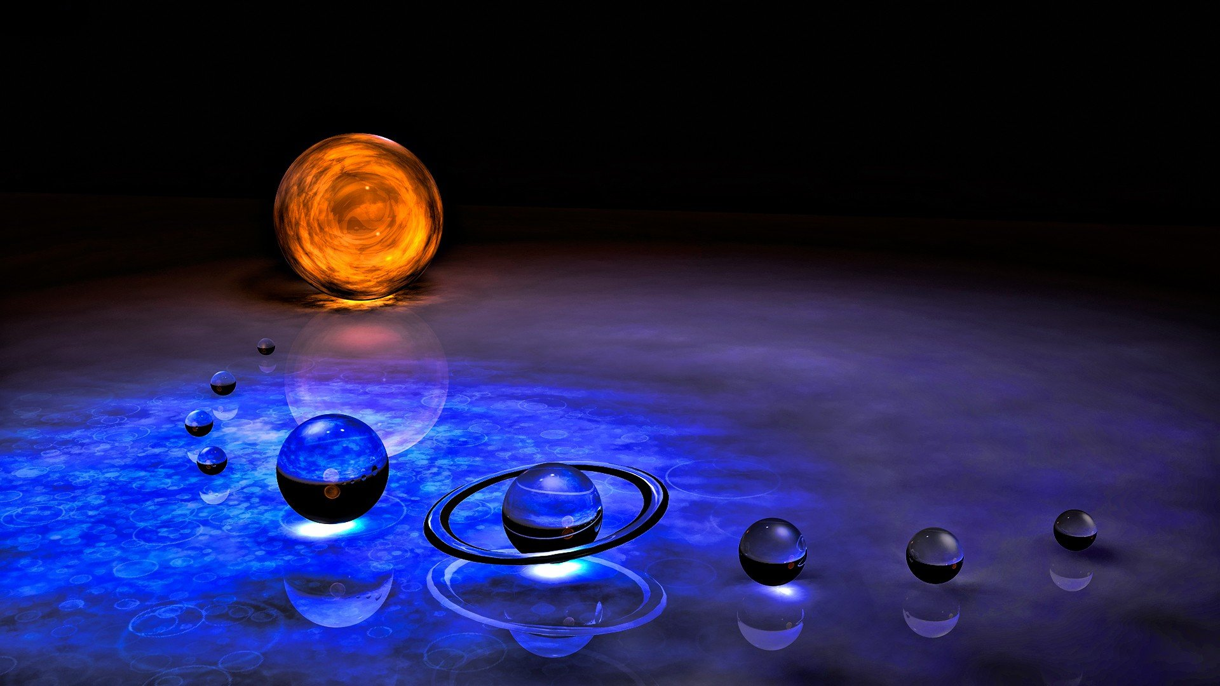
Challenges We Faced
When developing the UI to allow user input for timescale we had to google and find YouTube tutorials on how to use timescale to speed up process and how to implement it into a slider to give user accessibility
Getting realistic gravity working in our simulation
Notes:
Seth and Selina if you had issues making stuff can you please put them here

Slide 5
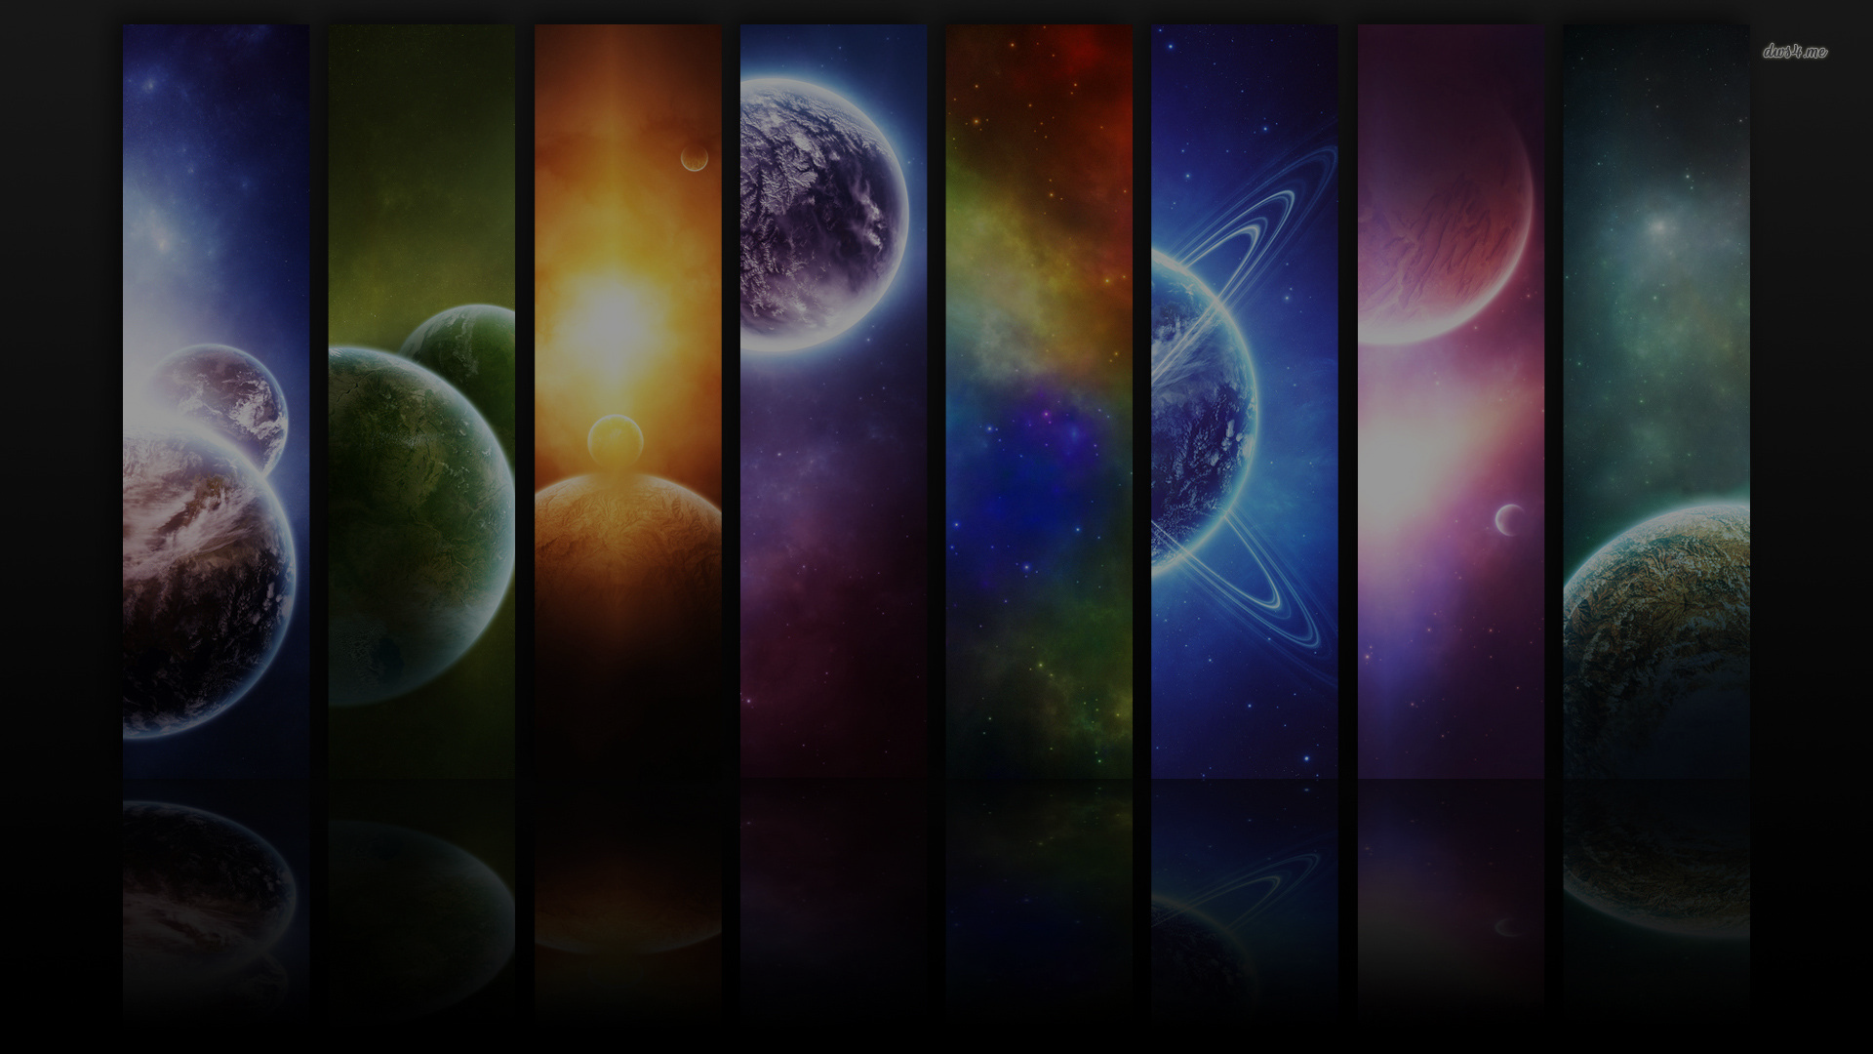
Remaining Features
The sunlight to give an effect on the objects in the solar system (IE. the shading and light reflection of the planets and asteroids)
Giving the user the ability to change camera views between the overview perspective (“bird eye view”) to looking the planets individually (camera follows a planet while it revolves around the sun).
Applying proper proportions to the planets and the sun (to closely resemble the original solar system)
Simulating the entire universe and then putting no gameplay on any of the planets resulting an uproar of gamers everywhere
Notes:
Seth and Selina if you have anything to put in, please put it here

Slide 6
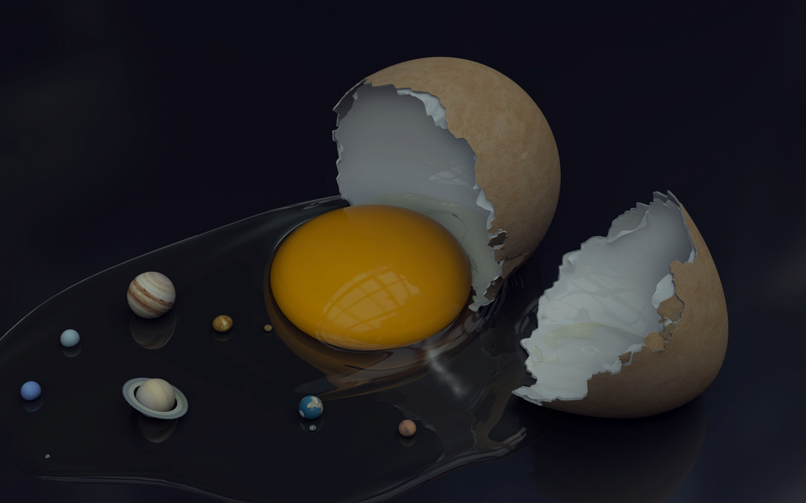
Questions?
We have answers….maybe?

